Slide 1


Infrastructure as Code (IaC) in AWS

Slide 2



Course: Mastering Amazon AWS
Lecture on: IAC on AWS
Instructor: Siddharth Sharma

Slide 3

ARCHITECTURAL NEED
To continue expanding business, you must begin automating. You need a method to reliably deploy, maintain and upgrade the numerous architectures your company has
Module Overview
  Need for Automation
  Automating Your Infrastructure
  Automating Deployment

Slide 4
Need for Automation

Slide 5
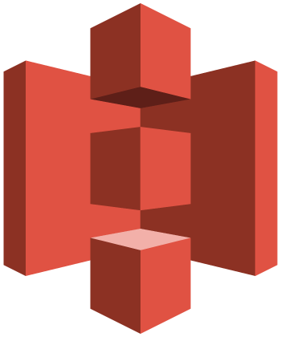
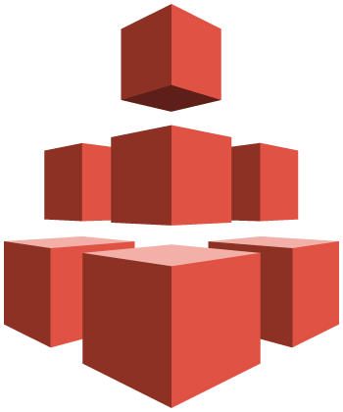
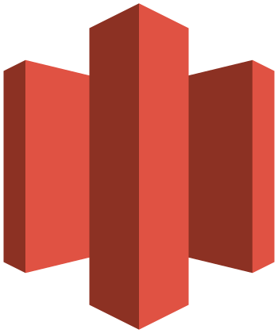
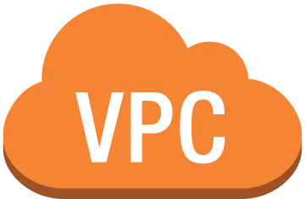




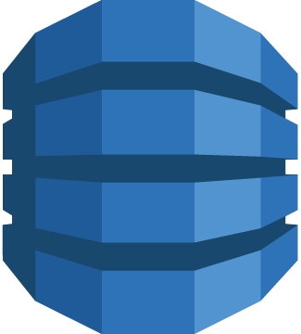
Without Automation
Set up your storage
Long manual process to build an architecture
Route your network
Create your instances
You
Console
Build your databases
Notes:
It takes significant time and energy to build a large-scale computing environment. Here are some questions to consider:
Where do you want to put your efforts: the design or the implementation? And what are the risks of manual implementations?
How do you update production servers? How are you going to roll out deployments across multiple geographic regions? When things break, and they will, how do you manage the rollback?
What about debugging deployments? How do you find what’s wrong and then fix it so that it says fixed?
How will you manage dependencies on the various systems and subsystems in your organization?
Finally, can you do all of this by hand?

Slide 6

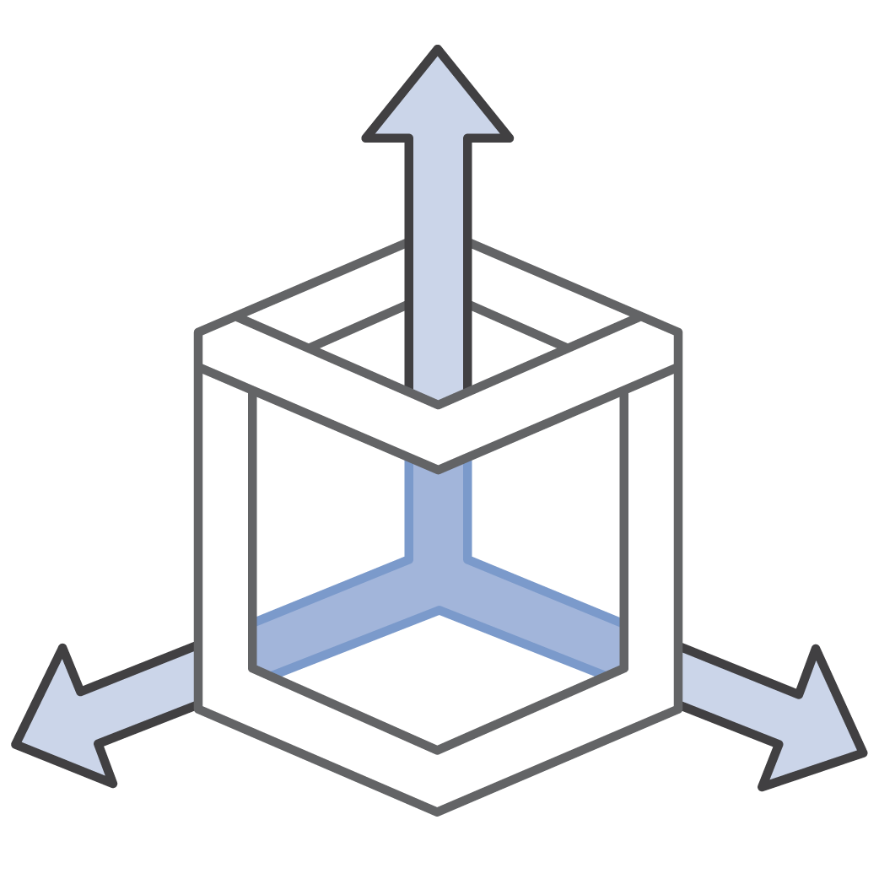


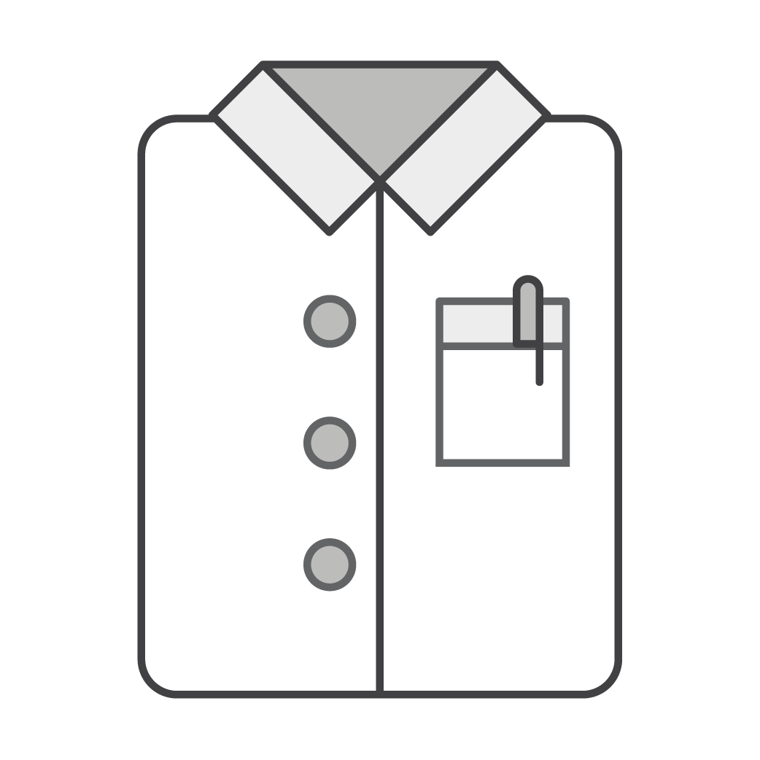
Manual Processes: Risks
Does not scale
No version
control
Lack of audit
trails
Inconsistent data management
Notes:
Having to manually create and add pieces to your environment does not scale. If you are responsible for a large corporate application, there are not enough people to manually sail the ship.
Creating architecture and applications by scratch doesn’t have inherent version control. In case of emergency, it’s helpful to roll back the production stack to a previous version—but that’s not possible when you create your environment manually.
Having an audit trail is very important for many compliance and security situations. It’s dangerous to allow people to manually control and edit your environment.
Finally, consistency is critical when minimizing risks. Automation allows you to maintain consistency.

Slide 7
In general, making manual changes in your production environment involves certain risks

Slide 8
Automating Your Infrastructure

Slide 9
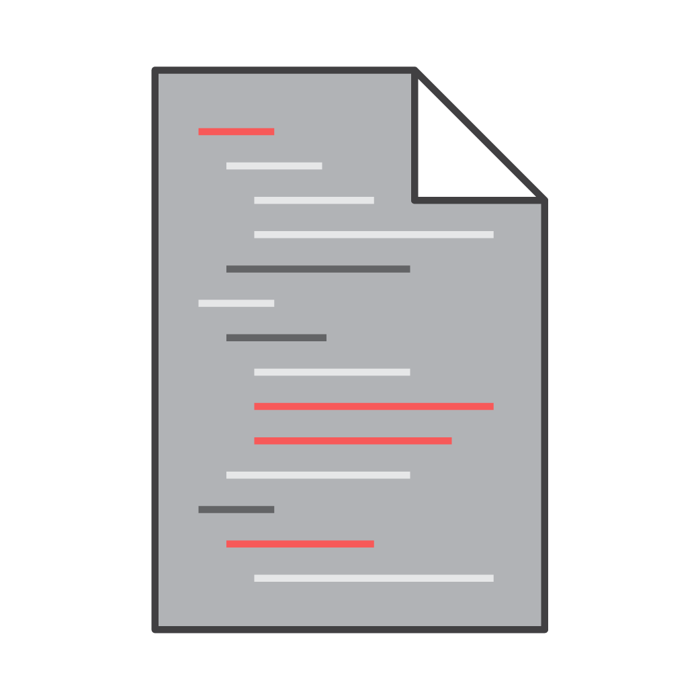
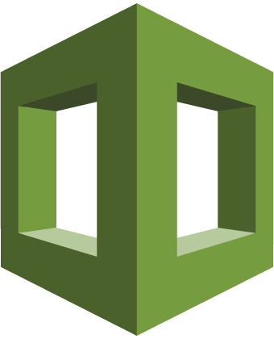
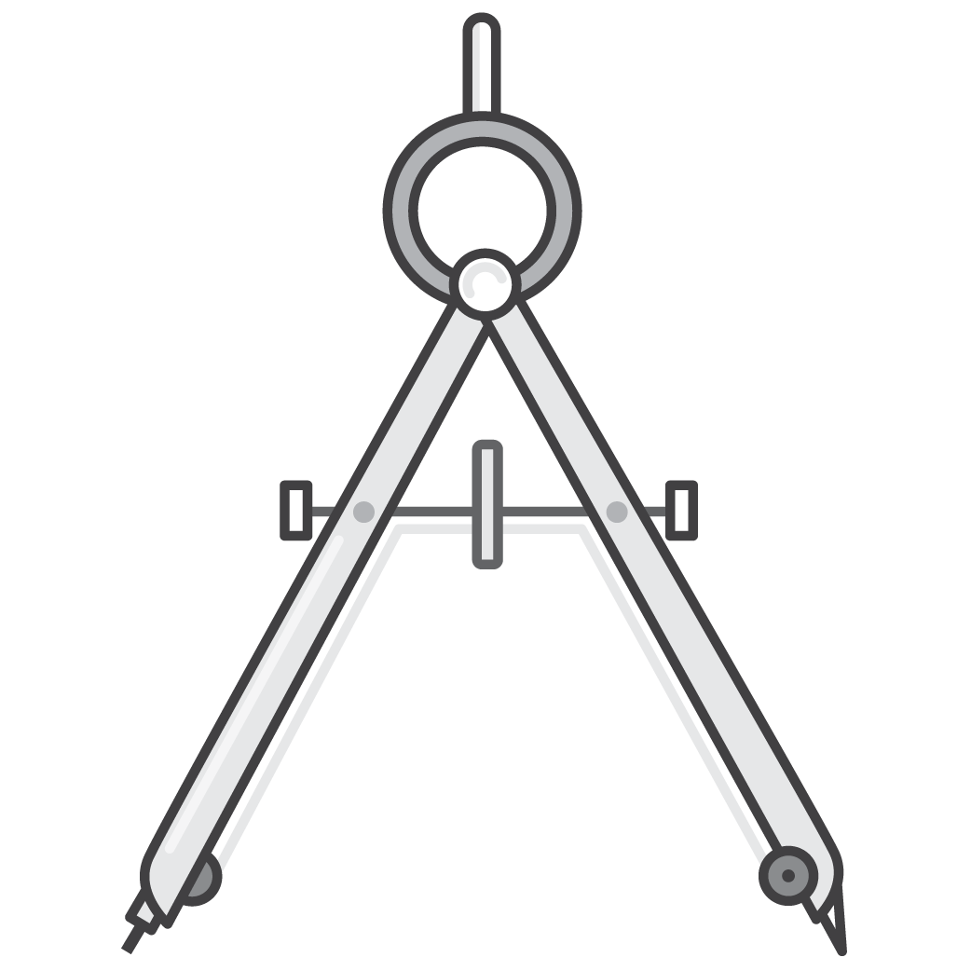
Automating Your Infrastructure
Provides your AWS infrastructure with a standard language to describe itself.
AWS CloudFormation
Generates and constructs specified resources automatically
Notes:
AWS CloudFormation provisions resources in a safe, repeatable manner, allowing you to build and rebuild your infrastructure and applications without having to perform manual actions or write custom scripts.
Using AWS CloudFormation allows you to treat your infrastructure as code. Author it with any code editor, check it into a version control system such as GitHub or AWS CodeCommit, and review files with team members before deploying into the appropriate environments.

Slide 10

How It Works
JSON
{
"Resources" : {
"HelloBucket" : {
"Type" : "AWS::S3::Bucket"
}
}
}
AWS CloudFormation templates
  JSON/YAML-formatted file describing the resources to be created
  Treat it as source code: Add it in your repository
  Import existing resources
YAML
Resources:
HelloBucket:
Type: AWS::S3::Bucket
Notes:
Additional points for an AWS CloudFormation template:
Treat it as code and manage it using your choice of version control (e.g., Git or SVN).
Define an entire application stack (all resources required for your application) in a JSON template file.
Define runtime parameters for a template (Amazon EC2 instance size, Amazon EC2 key pair, etc.).
You can now create YAML-formatted templates to describe your AWS resources and properties in AWS CloudFormation. Now, you have the option to use either YAML-formatted templates or JSON-formatted templates to model and describe your AWS infrastructure. YAML-formatted AWS CloudFormation templates follow the same anatomy as existing JSON-formatted templates and support all the same features.
You can also create cross stack references that let you share outputs from one stack with another stack. This lets you share things such as IAM roles, VPC information, and security groups. Previously, you needed to use AWS CloudFormation custom resources to accomplish this. Now, you can simply export values from one stack and import them to another stack using the new ImportValue intrinsic function.
Cross-stack references are useful for customers who separate their AWS infrastructure into logical components grouped by stack (e.g. a network stack, an application stack, etc.) and who need a way to loosely couple stacks together as an alternative to nested stacks.

Slide 11




Infrastructure as Code (IaC)
EC2
Architecture
stack
Security group
Architecture
template
AWS CloudFormation
engine
Subnet
AWS CloudFormation supports drift detection
Notes:
AWS CloudFormation makes deploying a set of Amazon Web Services (AWS) resources as simple as submitting a template to the service.
A template is a text file that describes and defines the resources to be deployed in an environment.
AWS CloudFormation is the engine that processes the template. The output of AWS CloudFormation is called a stack.
A stack is a collection of AWS resources deployed together as a group.
Additional points for an AWS CloudFormation template:
Treat it as code and manage it using a version control system.
Define an entire application stack (all resources required for your application) in a JSON or YAML template file.
Define runtime parameters for a template (Amazon EC2 instance size, Amazon EC2 key pair, etc.).
For a list of resources supported by AWS CloudFormation, see https://docs.aws.amazon.com/AWSCloudFormation/latest/UserGuide/aws-template-resource-type-ref.html.
For sample templates, see https://docs.aws.amazon.com/AWSCloudFormation/latest/UserGuide/cfn-sample-templates.html.
Performing a drift detection operation on a stack determines whether the stack has drifted from its expected template configuration, and returns detailed information about the drift status of each resource in the stack that supports drift detection. Drift detection can be enabled on a stack by clicking on “Detect Drift for current stack” dialog box. The process will continue the drift detection even if you close the dialog box and review the drift details later. For more information, see these sites:
https://docs.aws.amazon.com/AWSCloudFormation/latest/UserGuide/detect-drift-stack.html
https://docs.aws.amazon.com/AWSCloudFormation/latest/UserGuide/using-cfn-stack-drift.html

Slide 12

IaC: Benefits
Repeatability
Reusability
Development
Production
Load balancer
Load balancer
Load balancer
Load balancer
Auto Scaling group
Auto Scaling group
Auto Scaling group
Auto Scaling group
Notes:
If you build infrastructure with code, you gain the benefits of repeatability and reusability while building your environments.
With one template (or a combination of templates), you can build the same complex environments over and over again.
When doing this with AWS, you can even create environments dependent upon conditions, so that what ends up being built is specific to the context in which you've created it. For instance, a template can be designed so that different AMIs are used based on whether or not this template was launched into the development or the production environments.

Slide 13
IaC: Benefits
Repeatability
Reusability
Development
Production
Load balancer
Load balancer
Load balancer
Load balancer
Auto Scaling group
Auto Scaling group
Auto Scaling group
Auto Scaling group
Updated with new security groups
Notes:
In this scenario, the template has been updated to add new security groups to the instance stacks.
With one change to the template used to launch these environments, all four environments can have the new security group resource added.
This feature provides the benefit of easier maintainability of resources, as well as greater consistency and a reduction in effort through parallelization.

Slide 14



AWS CloudFormation Conditions
Production
Development
Web Tier
Web Tier
One template
App Tier
App Tier
RDS
(Primary)
RDS
(Standby)
Amazon RDS (Primary)
Availability Zone a
Availability Zone b
Availability Zone a
Notes:
Your production environment and development environment must be built from the same stack. This ensures that your application works in production the way it was designed and developed.
Additionally, your development environment and testing environment must use the same stack. All environments will have identical applications and configurations.
You might need several testing environments for functional testing, user acceptance testing, and load testing. Creating those environments manually comes with great risk.
You can use a Conditions statement in AWS CloudFormation templates to ensure that, while different in size and scope, development, test, and production are configured identically.

Slide 15

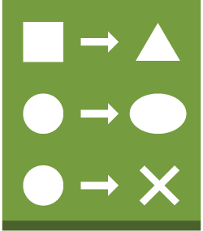
How to Update Stacks
Create
a change set
View
the change set
Run
the change set
Original stack
Change set
Inspect changes
AWS CloudFormation
When a resource's stack is updated or deleted, use a DeletionPolicy to protect it or create its backup
Notes:
One way to update your stacks is to edit your existing templates and run them again.
However, if you need additional insight about the changes AWS CloudFormation is planning to perform when it updates a stack, you can use a change set.
Change sets will let you preview the changes, allow you to verify they are in line with expectations, and then approve the update before proceeding.
This is the basic workflow for using change sets:
Create a change set by submitting changes for the stack that you want to update.
View the change set to see which stack settings and resources will change.
If you want to consider other changes before you decide which changes to make, create additional change sets.
Run the change set. AWS CloudFormation updates your stack with those changes.
With the DeletionPolicy attribute you can preserve or (in some cases) backup a resource when its stack is deleted or updated. For example, if you remove the resource from the stack template, and then update the stack with the template. You specify a DeletionPolicy attribute for each resource that you want to control. If a resource has no DeletionPolicy attribute, AWS CloudFormation deletes the resource by default. This capability does not apply to resources whose physical instance is replaced during stack update operations. For example, if you edit a resource's properties such that AWS CloudFormation replaces that resource during a stack update.
For more information, see: http://docs.aws.amazon.com/AWSCloudFormation/latest/UserGuide/using-cfn-updating-stacks-changesets.html.

Slide 16
Design Example
A layered architecture
Frontend
CRM web interface, admin interface, analytics dashboard
Backend
Customers, campaigns, products, marketing collateral, analytics
Shared
CRM DBs, common monitoring/alarms, subnets, security groups
Base network
VPCs, internet gateways, VPNs, NATs
Identity
IAM users, groups, roles

Slide 17
AWS Quick Starts
Standardised templates
Based on AWS best practices for security and high availability
Gold-standard deployments in AWS Cloud
Great for experimentation.
Can create entire architectures with one click and within an hour
AWS CloudFormation templates built by AWS Solutions Architects
Notes:
Quick Starts are built by AWS solutions architects and partners to help you deploy popular solutions on AWS, based on AWS best practices for security and high availability. These reference deployments implement key technologies automatically on the AWS Cloud, often with a single click and in less than an hour. You can build your test or production environment in a few steps, and start using it immediately.

Slide 18
What Is a Quick Start?
Template
Scripts
Bootstrapping
Deployment
Your account
Notes:
The Quick Start is made of an AWS CloudFormation template and associated scripts to create the environment in your AWS account. It deals with all the bootstrapping and deploying on your behalf. There is also a deployment guide that will tell you how everything was created.
You will be charged for the resources used in the creation of, and running of this environment.
For more information, see https://aws.amazon.com/quickstart/

Slide 19
Automating Deployments

Slide 20


How to Modify Your Fleet
Web app
System updates
Amazon RDS (primary)
Availability Zone
Notes:
You can create an entire infrastructure automatically by using AWS CloudFormation, but there are still some important questions to ask.
How do update your Amazon EC2 instances? Are you supposed to log into each box and run update commands yourself? Download the newest version of your web app? How do you revert a change if something goes wrong? What if you have 100 servers that run three different apps?
There are traditional tools that can help with these scenarios, but an out-of-the-box solution would be more convenient.

Slide 21

Systems Manager
  A collection of capabilities that allow for continuous, automated system management at scale and automated configuration
    Across all your Windows and Linux workload
    Runs in Amazon EC2 or on-premises
AWS Systems Manager
Notes:
AWS Systems Manager is a management service that helps you automatically collect software inventory, apply OS patches, create system images, and configure Windows and Linux operating systems. These capabilities help you define and track system configurations, prevent drift, and maintain software compliance of your Amazon EC2 and on-premises configurations. By providing a management approach that is designed for the scale and agility of the cloud but extends into your on-premises data center, AWS Systems Manager makes it easier for you to seamlessly bridge your existing infrastructure with AWS.
You can open AWS Systems Manager from the Amazon EC2 console. Select the instances you want to manage, and define the management tasks you want to perform. AWS Systems Manager is available at no cost to manage both your Amazon EC2 and on-premises resources.

Slide 22





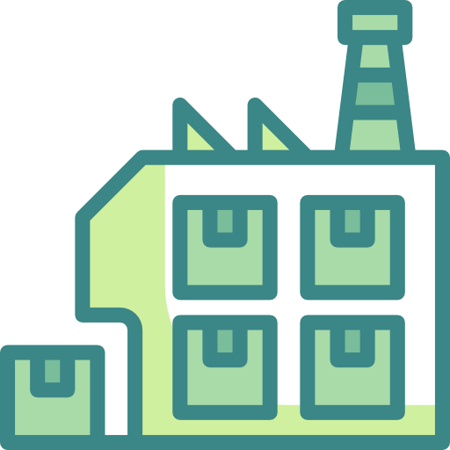
What Can It Do?
Run commands
Maintenance Windows
Patch management
State Manager
Session Manager
Inventory
Notes:
Use Systems Manager Run Command to remotely and securely manage the configuration of your managed instances at scale. Use Run Command to perform on-demand changes like updating applications or running Linux shell scripts and Windows PowerShell commands on a target set of dozens or hundreds of instances.
For more information, see: https://docs.aws.amazon.com/systems-manager/latest/userguide/execute-remote-commands.html
Use Patch Manager to automate the process of patching your managed instances. This capability enables you to scan instances for missing patches and apply missing patches individually or to large groups of instances by using Amazon EC2 instance tags. For security patches, Patch Manager uses patch baselines that include rules for auto-approving patches within days of their release, as well as a list of approved and rejected patches. Security patches are installed from the default repository for patches configured for the instance. You can install security patches on a regular basis by scheduling patching to run as a Systems Manager Maintenance Window task. For Linux operating systems, you can define the repositories that should be used for patching operations as part of your patch baseline.
This allows you to ensure that updates are installed only from trusted repositories regardless of what repositories are configured on the instance. For Linux, you also have the ability to update any package on the instance, not just those that are classified as operating system security updates.
For more information, see: https://docs.aws.amazon.com/systems-manager/latest/userguide/systems-manager-patch.html
Use Maintenance Windows to set up recurring schedules for managed instances to run administrative tasks like installing patches and updates without interrupting business-critical operations.
For more information, see: https://docs.aws.amazon.com/systems-manager/latest/userguide/systems-manager-maintenance.html
Use Systems Manager State Manager to automate the process of keeping your managed instances in a defined state. You can use State Manager to ensure that your instances are bootstrapped with specific software at startup, joined to a Windows domain (Windows instances only), or patched with specific software updates.
For more information, see: https://docs.aws.amazon.com/systems-manager/latest/userguide/systems-manager-state.html
Use Session Manager to manage your Amazon EC2 instances through an interactive one-click browser-based shell or through the AWS CLI. Session Manager provides secure and auditable instance management without the need to open inbound ports, maintain bastion hosts, or manage SSH keys. Session Manager also makes it easy to comply with corporate policies that require controlled access to instances, strict security practices, and fully auditable logs with instance access details, while still providing end users with simple one-click cross-platform access to your Amazon EC2 instances.
For more information, see: https://docs.aws.amazon.com/systems-manager/latest/userguide/session-manager.html
Use Inventory for visibility into your Amazon EC2 and on-premises computing environment. You can use Inventory to collect metadata from your managed instances.
For more information, see: https://docs.aws.amazon.com/systems-manager/latest/userguide/systems-manager-inventory.html
Session Manager icon made by smalllikeart from www.flaticon.com
Inventory Icon made by wanicon from www.flaticon.com

Slide 23

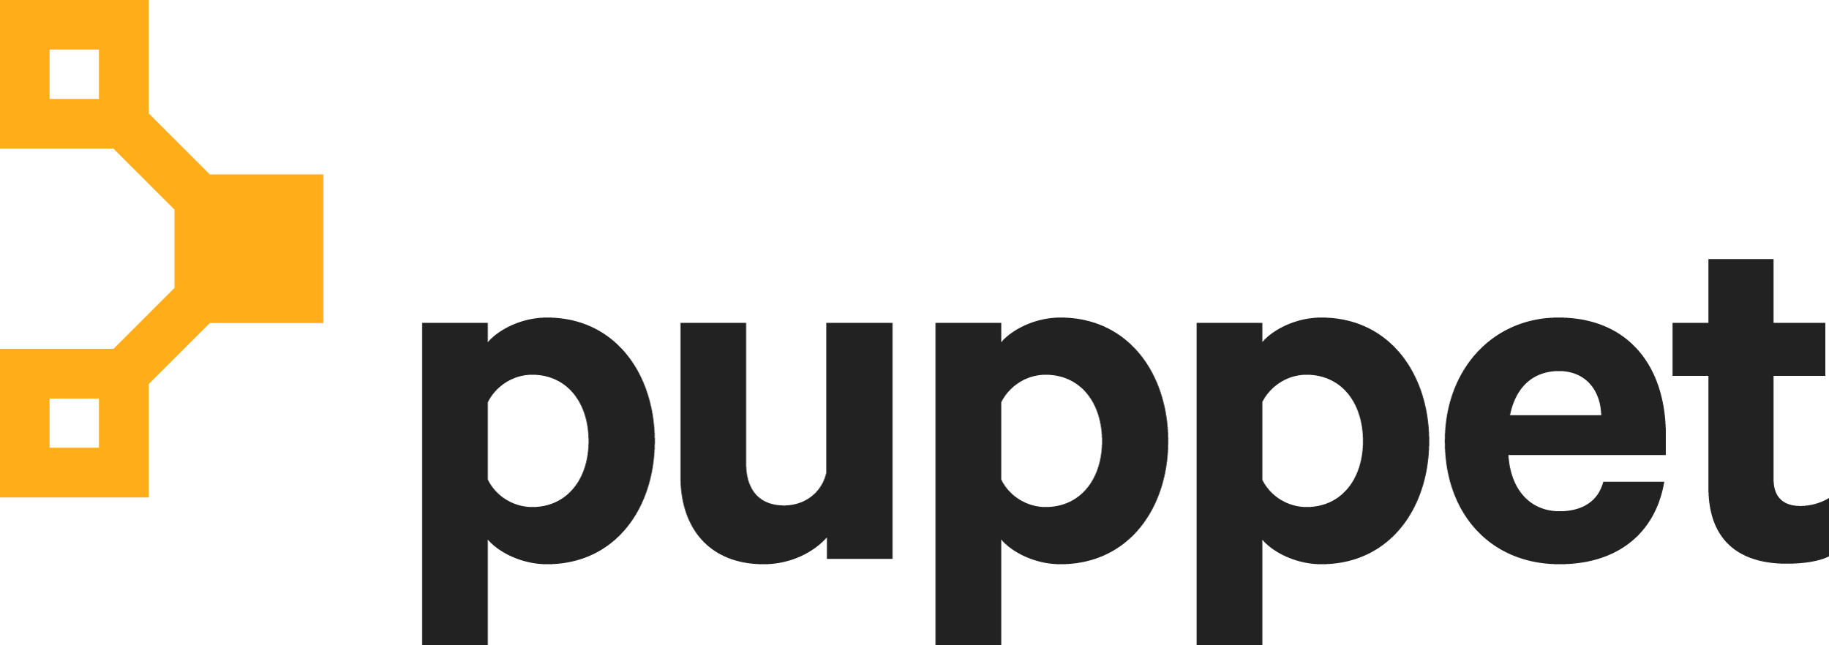
AWS OpsWorks for Infrastructure and Deployment Automation
Configuration management services
AWS OpsWorks for Puppet Enterprise
AWS OpsWorks for Chef Automate
AWS OpsWorks Stacks
AWS OpsWorks
Notes:
AWS OpsWorks Stacks is a configuration management service that helps you configure and operate applications of all shapes and sizes using Chef. You can define the application’s architecture and the specification of each component, including package installation, software configuration and resources such as storage. Start from templates for common technologies such as application servers and databases or build your own to perform any task that can be scripted. AWS OpsWorks Stacks includes automation to scale your application based on time or load and dynamic configuration to orchestrate changes as your environment scales.
AWS OpsWorks for Chef Automate provides a fully managed Chef Automate server and suite of automation tools that give you workflow automation for continuous deployment, automated testing for compliance and security, and a user interface that gives you visibility into your nodes and their status. The Chef Automate platform gives you full stack automation by handling operational tasks such as software and operating system configurations, continuous compliance, package installations, database setups, and more. The Chef server centrally stores your configuration tasks and provides them to each node in your compute environment at any scale, from a few nodes to thousands of nodes. OpsWorks for Chef Automate is completely compatible with tooling and cookbooks from the Chef community and automatically registers new nodes with your Chef server.
AWS OpsWorks for Puppet Enterprise provides a managed Puppet Enterprise server and suite of automation tools that give you workflow automation for orchestration, automated provisioning, and visualization for traceability. The Puppet Enterprise server gives you full stack automation by handling operational tasks such as software and operating system configurations, package installations, database setups, and more. The Puppet master server centrally stores your configuration tasks and provides them to each node in your compute environment at any scale, from a few nodes to thousands of nodes.

Slide 24
OpsWorks Stacks: Life Cycle Events
Allows you to run scripts on these triggers:
  Setup occurs on a fresh instance following a successful boot
  Configure occurs whenever an instance enters or exits the online state on all the stack's instances.
  Deploy occurs when you deploy an app
  Undeploy occurs when you delete an app
  Shutdown occurs when you stop an instance
AWS OpsWorks
Stacks

Slide 25

OpsWorks Stacks: Stacks and Layers
PHP application stack
The stack is an assembly of linked AWS resources and EC2 instances that you want to operate as a group for a common objective
You can configure the VPC, region, security groups, default IAM role, default IAM instance profile, etc. in a stack
Notes:
The fundamental unit of creation in an AWS OpsWorks Stacks application is the stack. You can think of this much in the way you think of an AWS CloudFormation stack: i.e., as the collection of resources utilized by your system. Unlike AWS CloudFormation, however, AWS OpsWorks Stacks applications contain another layer of management that ultimately simplifies deployment and configuration.

Slide 26


OpsWorks Stacks: Layers
Every AWS OpsWorks Stacks stack contains one or more layers
Two types of layers:
  Service layer: Contains an AWS service, such as Amazon RDS
  OpsWorks layer: Contains a set of Amazon EC2 instances
Instances can only be added to the levels of OpsWorks Stacks; they cannot be added directly to the service layers or only the stack
PHP application stack
ELB
Scalable PHP app layer
Amazon RDS layer
Notes:
After a stack is created, you can add multiple layers to that stack, building out your application as a set of interacting layers of related functionality.

Slide 27
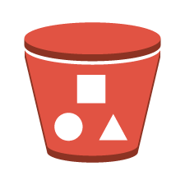
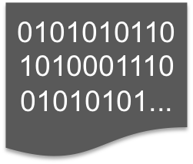
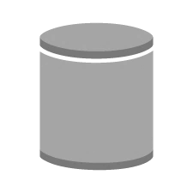
Customising Layers
Customising layers involves writing new Chef recipes and cookbooks
Chef Cookbook
Publish custom cookbooks
Templates
Attributes
Recipes
Amazon S3 bucket
Web server
Attach a recipe to a life cycle event
OpsWorks Stacks Layer
Git or Subversion
Notes:
Suppose that you have a need to customize an existing layer ( e.g., you want to add additional functionality to the instances in your PHP app server layer), such as a series of custom library packages required by your application. Or, suppose that you need to create a layer for an application type that currently isn't provided as a default layer by AWS OpsWorks Stacks, e.g., a Go application layer, or a Redis layer.
You can customize the instances on an AWS OpsWorks Stacks layer by creating custom cookbooks. AWS OpsWorks Stacks layers use Chef cookbooks to handle tasks such as installing and configuring packages and deploying apps. Custom cookbooks are the key to AWS OpsWorks Stacks’ power and flexibility. By creating and attaching new recipes in this method, it's possible to create a layer that initializes the application environment for each instance added to the layer to fit your specific needs.

Slide 28


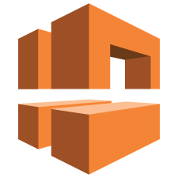



Using AWS OpsWorks Stacks With AWS CloudFormation
Build the infrastructure (VPC, IAM roles) using AWS CloudFormation and then use AWS OpsWorks Stacks to deploy the application layer
PHP application stack
Load balancing layer
Amazon VPC
Alarms
Scalable PHP app layer
Amazon RDS layer
Logs
IAM Permissions
Notes:
Because AWS OpsWorks Stacks can be created via AWS CloudFormation, the use of the two technologies is not mutually exclusive. You can use a set of tiered AWS CloudFormation templates in which one template creates the infrastructure for your environment (e.g., an Amazon VPC, IAM roles, an Amazon SQS queue for communication with external applications) and then uses a separate AWS CloudFormation template to create the AWS OpsWorks Stacks stack that will be deployed within that infrastructure.

Slide 29
A little more hands off

Slide 30
General Challenges
Lack of consistency across multiple projects or applications
Managing and configuring servers is time-consuming
Managing infrastructure around deploying an app can be difficult

Slide 31

AWS Elastic Beanstalk
Completely transparent: You can view everything that is created
Impossible to outgrow; automatically scales your application up and down
Provisions and operates the infrastructure and manages the application stack for you
AWS Elastic Beanstalk

Slide 32
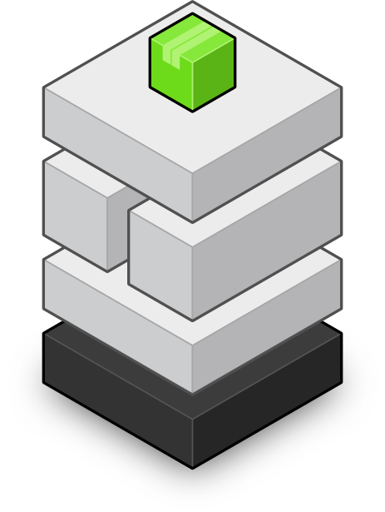
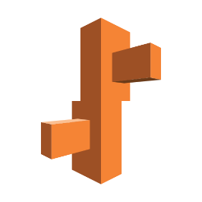
What Do You Control?
You
Code
HTTP server
Application server
Language interpreter
Operating system
Host
Notes:
The goal of AWS Elastic Beanstalk is to help developers deploy and maintain scalable web applications and services in the cloud without having to worry about the underlying infrastructure. Elastic Beanstalk configures each EC2 instance in your environment with the components necessary to run applications for the selected platform. You don’t have to worry about logging into instances to install and configure your application stack.

Slide 33


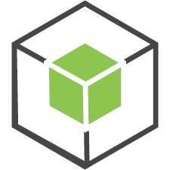

Elastic Beanstalk: Environment
Elastic Beanstalk provisions the necessary infrastructure resources
Elastic Beanstalk gives your application environment a unique domain name
(e.g., yourapp.elasticbeanstalk.com)
  You can resolve your domain name to this domain name with Route 53
http://[your app].elasticbeanstalk.com
Alert
ELB
Log
App
Mon
Availability Zone
Notes:
There are two types of environments you can choose from when working with AWS Elastic Beanstalk. The single-instance environment will allow you to launch a single EC2 instance and will not include load balancing or Auto Scaling. The other type of environment can launch multiple EC2 instances and includes load balancing and Auto Scaling configuration.
Elastic Beanstalk provisions necessary infrastructure resources, such as ELB, Auto Scaling groups, security groups, and databases (optional).

Slide 34

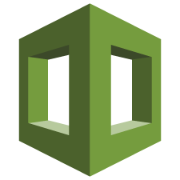
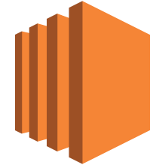
Choosing the Right Solution
Higher-level services
Do it yourself
AWS Elastic Beanstalk
AWS
OpsWorks
AWS
CloudFormation
Amazon
EC2
Convenience
Control
Notes:
One frequently asked question is about the multiple services that provide application management capabilities, and where the line between them is. It really depends on the level of convenience and control that you need.
AWS Elastic Beanstalk is an easy-to-use application service for building web applications with a popular container: Java, PHP, Node.js, Python, Ruby, and Docker. If you want to upload your code and don’t need to customize your environment, Elastic Beanstalk may be a good choice for you.
AWS OpsWorks lets you launch an application and define its architecture and the specification of each component, including package installation, software configuration and resources, such as storage. You can use templates for common technologies (app servers, databases, etc.) or you can build your own template instead.

Slide 35
Lab: Automating Infrastructure Deployment With AWS CloudFormation

Slide 36
Lab 5: Automating Infrastructure Deployment
”I want to deploy infrastructure in a consistent, repeatable manner.”
Technologies used
AWS CloudFormation

Slide 37
Lab 5: Automating Infrastructure Deployment
You will deploy infrastructure in layers:
Network layer
Application layer
You will also:
Update a stack
Delete a stack that has a deletion policy

Slide 38
Thank You!

